Slide 1
HKN ECE 310 Review Session
09/24/2023
Whomst: Eric, Ethan, Bex

Slide 2
Logistics
This session is not recorded.
Slides can be found on the HKN website (Google ‘HKN UIUC’, it will be the first link that pops up.
Extra office hours will be held on 9/27 at 6 pm in the RSO Office (next to the Daily Byte). They will end when your exam begins.

Slide 3
Overview
Topics
CT and DT Signals
LSI and LSIC Systems
Impulse Response
Z-transforms
Stability, Causality, etc
Multiple Systems
Notes:
CT/DT - 1 slide
LSI/LSIC - 10 slides
Impulse Response - 9 slides
Z-transforms - 10 slides
Stability/Causality - 6 slides
Multiple Systems - 1 slide

Slide 4
CT and DT Signals
Discrete-Time (DT) Signals are really just Continuous-Time (CT) Signals, but sampled
Example: your phone battery level
𝑥[𝑛] represents DT signals, while it is written as 𝑥(𝑡) for CT
Frequency can also be either Discrete or Continuous - You’ll learn how to deal with this later.

Slide 5
LSI and LSIC Systems aka LTI and LTIC Systems
Given a system H which produces output y[n] on input x[n], we can check for three properties:
Linearity: Saying system H is linear is equivalent to saying:
Given 𝑥₁[𝑛] → 𝑦₁[𝑛], and given 𝑥₂[𝑛] → 𝑦₂[𝑛], then 𝑎𝑥₁[𝑛] + 𝑏𝑥₂[𝑛] → 𝑎𝑦₁[𝑛] + 𝑏𝑦₂[𝑛]
Any scaling and summing of original inputs is equivalently reflected in the outputs
Shift Invariance: Saying H is SI (shift invariant) or TI (time-invariant) is equivalent to saying:
Given 𝑥[𝑛] → 𝑦[𝑛], then 𝑥[𝑛−𝑘] → 𝑦[𝑛−𝑘]
Any delay in the original input is equivalently reflected in the output
Causality: output cannot depend on future input values.
No “official” formal definition in this class.

Slide 6
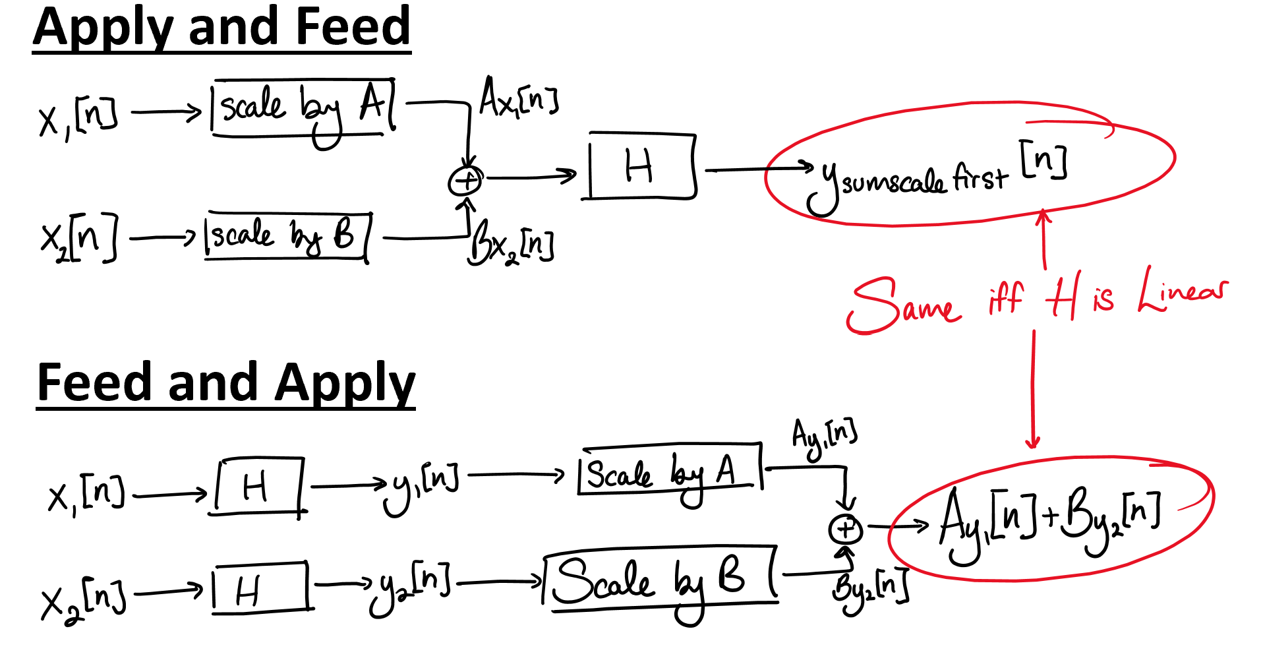
Pictographic Representation of Linearity

Slide 7
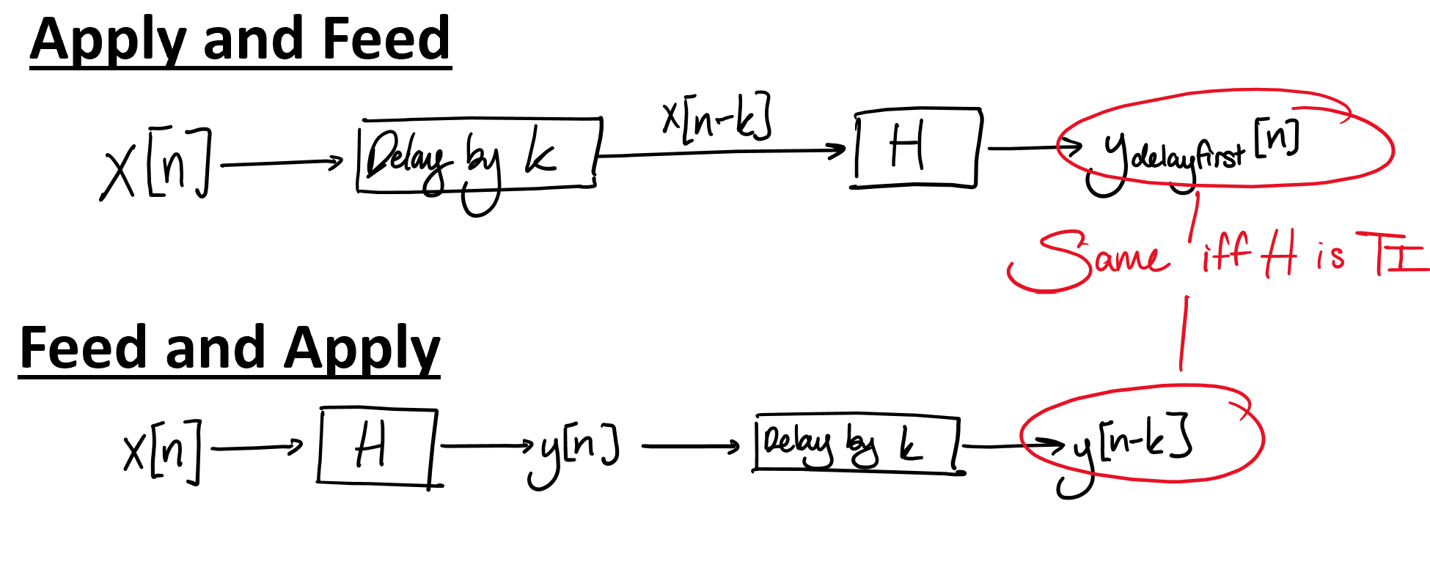
Pictographic Representation of Shift Invariance

Slide 8
General Approach on Proving L/TI
Feed and apply
Define input/output pairs to the system
𝑥[𝑛] → 𝑦[𝑛]
Apply transformation to the outputs
Apply and feed
Define a new function applying whatever variant
Testing time invariance: 𝑔[𝑛] = 𝑥[𝑛−𝑘]
Testing linearity: 𝑔[𝑛] = 𝑎𝑥₁[𝑛] + 𝑏𝑥₂[𝑛]
(Not strictly necessary, but it’s easy to get lost…)
Feed this into the system determine output 𝑦ℊ[𝑛]
Compare the results from steps 1 & 2.

Slide 9
Examples: Proving LTI via a system’s equations
𝑥[2𝑛]
𝑛²
Prove, or disprove, that 𝑦[𝑛] = is linear.
Prove, or disprove, that 𝑦[𝑛] = is time invariant.
Prove, or disprove, that 𝑦[𝑛] = 𝑥[𝑛] + 𝑥[2023] is time invariant.
𝑥[𝑛−𝝰]
𝑥[𝑛−𝝱]
Notes:
Yes, yes, no (need to formally prove)

Slide 10
Causality of Systems via their Equations
Suppose we have some equation describing some system
𝑦[𝑛] = 𝑥[𝑛−4] + 𝑦[𝑛−1] + 𝑛²𝑥[𝑛]
“Current outputs cannot depend on future inputs”
A more formal definition (for those who want):
The maximum index of y (call it 𝑛y ), must always be greater or equal to the maximum index of x (call it 𝑛x) at any point in time

Slide 11
Justifying Causality of Systems via their Equations
For every system, determine whether it is causal or not and justify.
𝑦[𝑛] = 𝑥[𝑛] + 𝑦[𝑛−1] + 𝑥[𝑛−200] + 𝑥[⌊ ⌋]
𝑦[𝑛]= 𝑥[𝑛] + 𝑥[𝑛−1] + 𝑥[𝑛−2] + …
𝑦[𝑛] = cos(2023𝑛)
𝑦[𝑛] = 𝑥[|𝑛|]
𝑦[𝑛] = |𝑥[𝑛]|
𝑦[𝑛] − 𝑦[𝑛−3] = 𝑥[𝑛+2]
𝑛
2
Notes:
non-causal
causal
causal
non-causal ex: n=-1
causal
non-causal

Slide 12
BIBO Stability of Systems via their Equations
Given a system H, the system is BIBO stable if and only if every bounded input 𝑥[𝑛] produces a bounded output 𝑦[𝑛].
That is, if |𝑥[𝑛]| < 𝞫 for some 𝞫, then |𝑦[𝑛]| < 𝞪 for some 𝞪.
“Bounded output” must be well-defined output
We can check for BIBO stability even if the system isn’t LTI
Proof: FA21 got tested on it…

Slide 13
Justifying BIBO Stability of Systems via their Equations
Determine whether the following sequences are BIBO stable or not. If not, provide a bounded input that causes the input to be unbounded.
𝑦[𝑛] = 20𝑥[𝑛]
𝑦[𝑛] =
𝑦[𝑛] = +
𝑦[𝑛] = 𝑥[𝑛] + 𝑥[𝑛−1] + 𝑦[𝑛−1]
𝑦[𝑛] = 𝑥[𝑛](−1)ⁿ − 2𝑦[𝑛−1]
(½)ⁿ𝑥[𝑛]
𝑥[310]
𝑥[𝑛]
1−(𝑥[𝑛]−5)²
1
𝑛²
Notes:
BIBO stable. Justification: Given x[n], set bounds on the value of y[n]
Not stable. If x[310]=0, then fraction is undefined.
Not stable. If x[n]=5, ever, then fraction is undefined.
Not stable (marginally stable) (Consider x[n]=u[n], creates unbounded output) (Z-transform has pole at z=1, so ROC does not include unit circle!)
Not stable (challenge question)

Slide 14
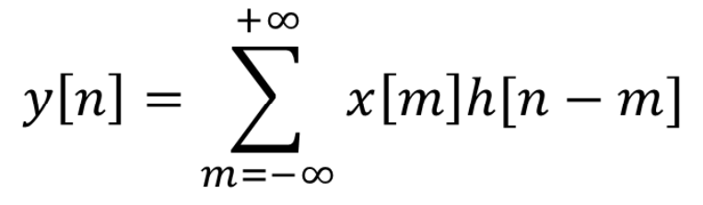
Impulse Response
Let 𝑥[𝑛] be the input to an LSI system with impulse response ℎ[𝑛]. Then, the system output 𝑦[𝑛] is given by
Equivalently, 𝑦[𝑛] = 𝑥[𝑛] ∗ ℎ[𝑛].
Three ways of determining the output:
Graphical method
Flipping a sequence + sequential multiplication and adding
Plug it into scipy

Slide 15
Which of the following make sense?
Let x[n] be some arbitrary signal. Let h[n] be the impulse response of some linear system.
x[n] is linear.
x[n] is shift-invariant.
x[n] is causal.
x[n] is BIBO-stable.
x[n] is unbounded.
h[n] is linear.
h[n] is shift-invariant.
h[n] is causal.
h[n] is BIBO-stable.
h[n] is unbounded.
Notes:
5, 6, 7, 8, 9 make sense. The rest don’t. Beware of abuse of terminology!

Slide 16
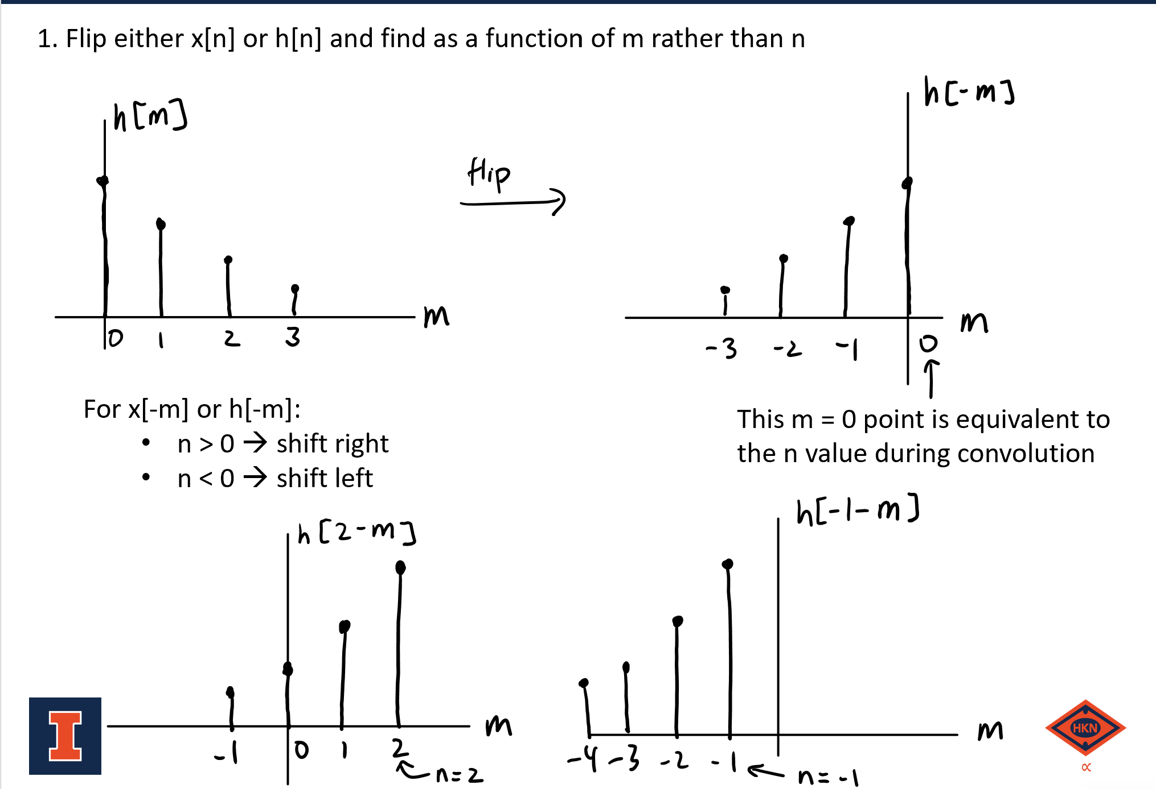
Graphical Method

Slide 17
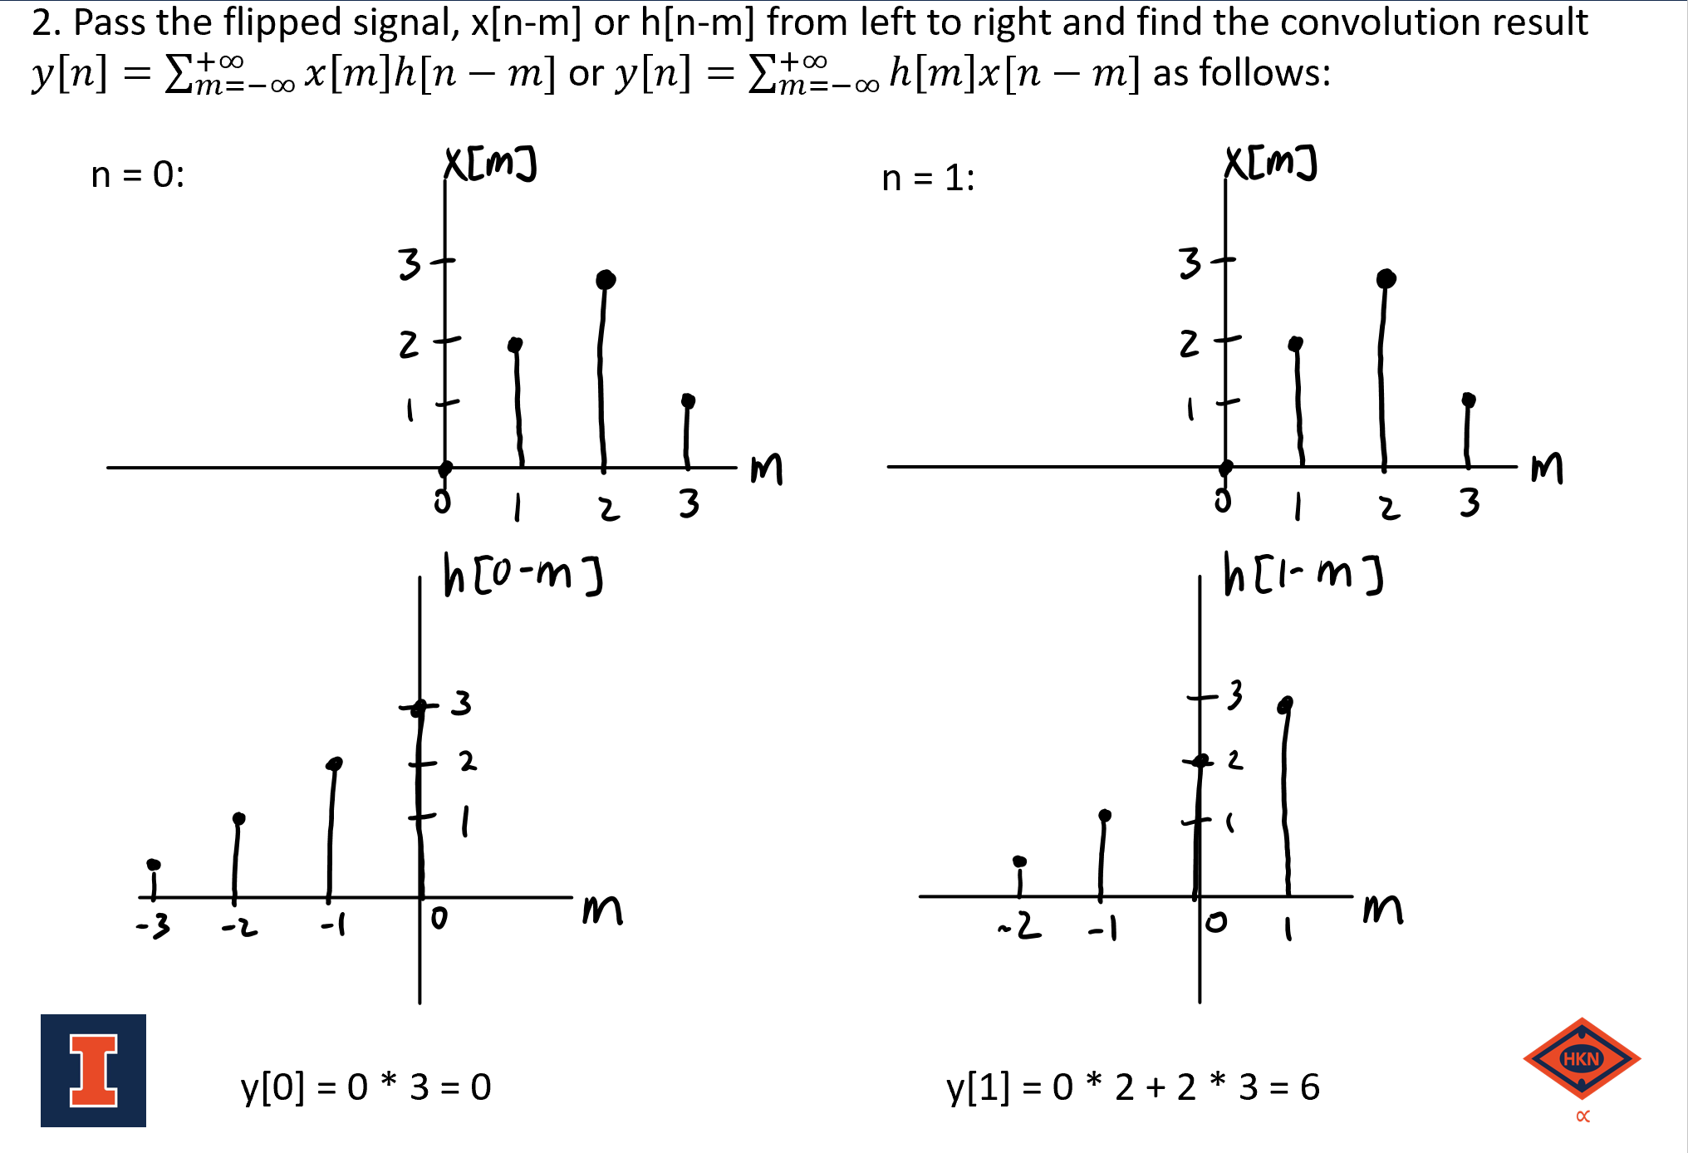
Graphical Method (cont)

Slide 18
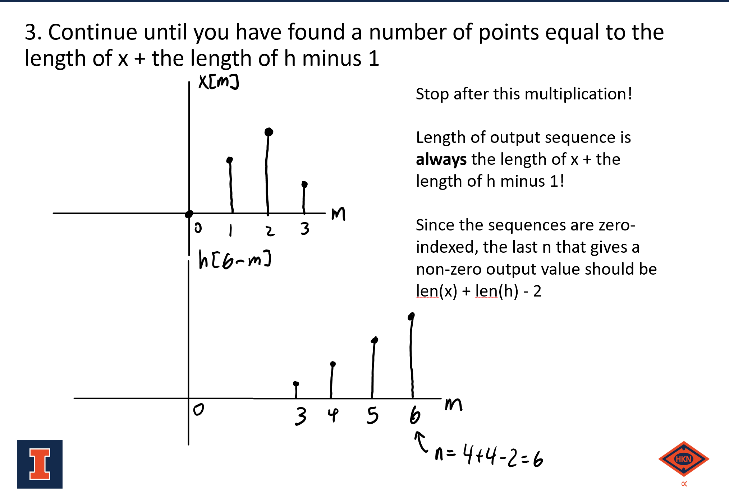
Graphical Method (cont)

Slide 19
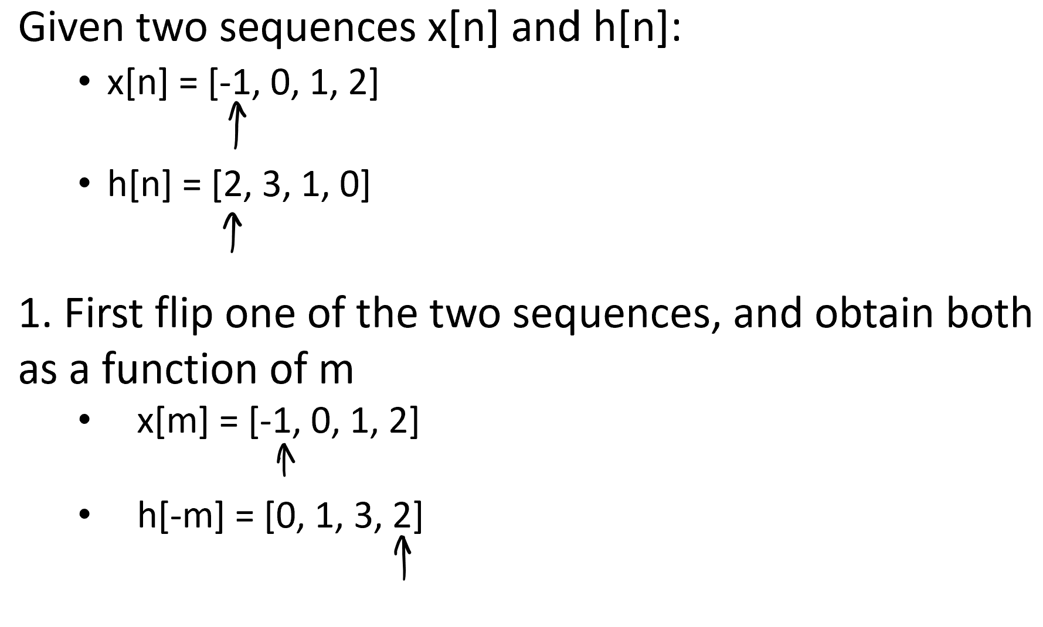
Sequence Method

Slide 20
Sequence Method (cont)
2. Similar to the graphical method, shift the flipped sequence from left-to-right, multiplying overlapping elements and adding the products together for each n
n = 0:
n = 1:
And so on…
x[m] = [-1, 0, 1, 2]
x[m] = [-1, 0, 1, 2]
h[0-m] = [0, 1, 3, 2]
h[1-m] = [0, 1, 3, 2]
y[0] = -1 * 2 = -2
y[1] = -1 * 3 + 0 * 2 = -3

Slide 21
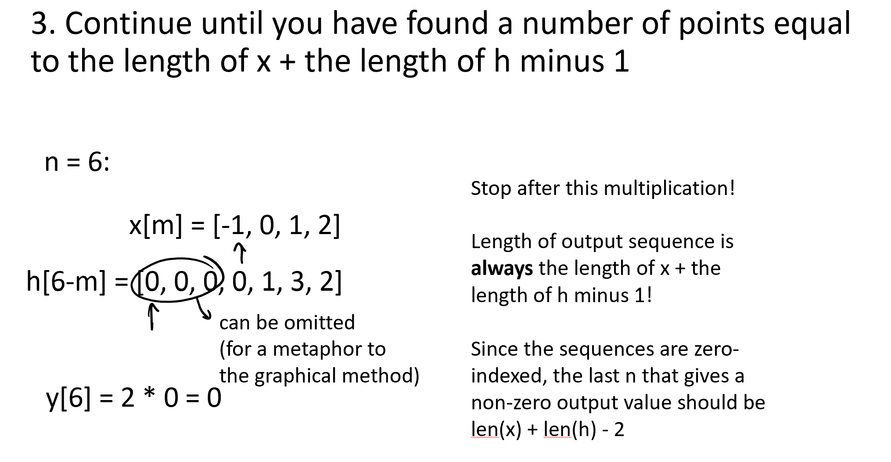
Sequence Method (cont)

Slide 22
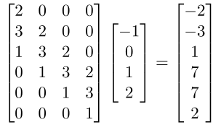
Matrix Method
Turn one of your signals to a column vector, the other to a matrix. Multiply -> Profit
x[n] = [-1, 0, 1, 2]
h[n] = [2, 3, 1, 0]

Slide 23
Impulse response and causality
Suppose we have an LTI system with impulse response h[𝑛].
The system is causal (the system is LTIC) implies: h[𝑛] = 0 for 𝑛 < 0.
Signals for which 𝑥[𝑛] = 0 for n < 0 are called “causal signals” for this reason.
The system is non-causal implies h[𝑛] ≠ 0 for n < 0

Slide 24
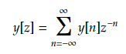
Z-transforms
Typically perform inverse z-transform by inspection or by partial fraction decomposition
Important properties:
Linearity
Multiplication
Delay property
Use properties whenever you can to go fast on the test!
A Z-transform is uniquely determined by TWO things:
Expression for transform, F(z)
Region of Convergence, range of |z|
Continuous region
Does not include poles
Convolution theorem: 𝑥[𝑛] ∗ ℎ[𝑛] ↔ X(z)H(z)
Notes:
(NOTE: top equation should be Y(z) = …)

Slide 25
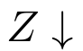
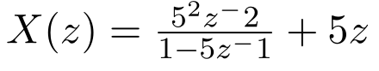
Z-transforms: Example

Slide 26
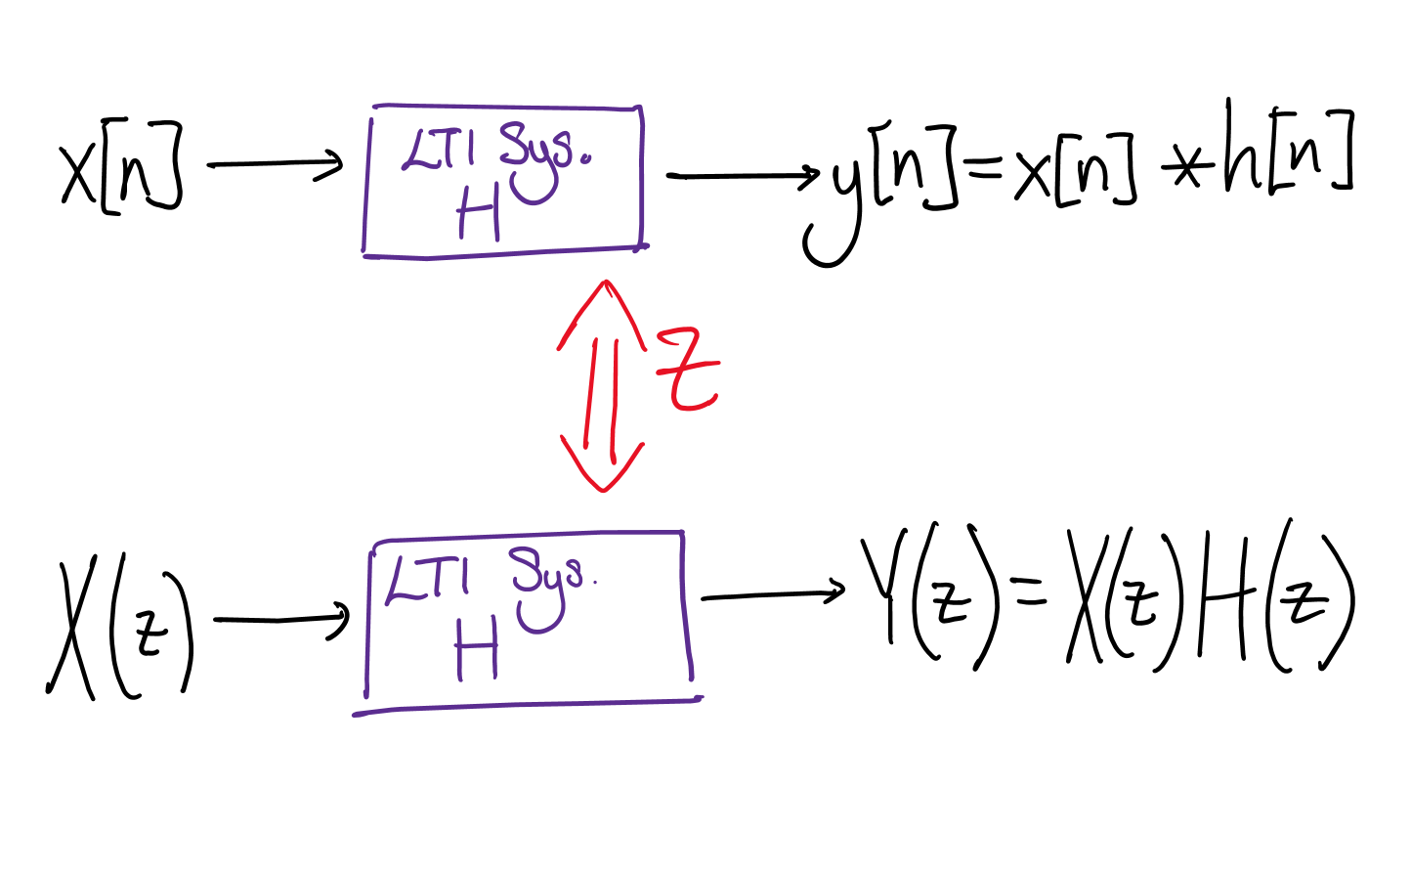
Convolution Theorem in a Picture

Slide 27
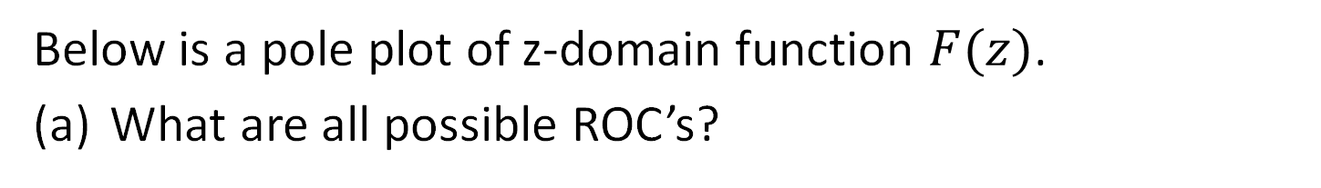
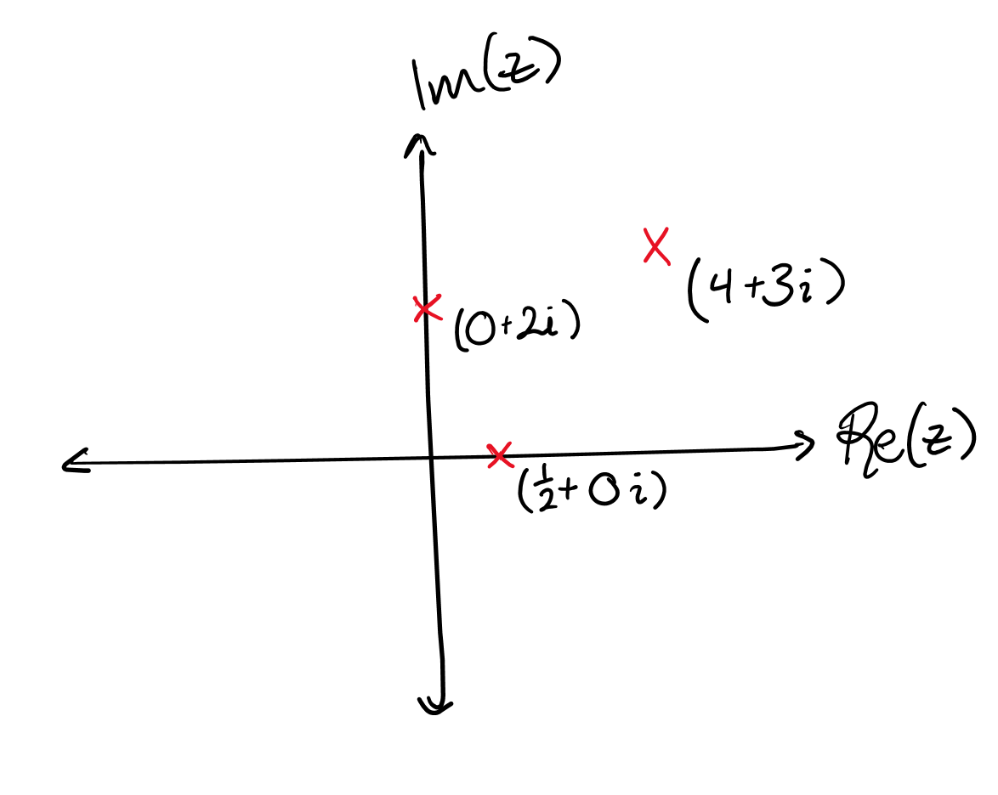
Concept check: Possible ROCs
Notes:
Answer: Four different ROCs:
|z| < 1/2 , ½ < |z| < 2, 2 < |z| < 5, |z| > 5

Slide 28
ROCs and Sequences – General Patterns
Suppose we have 𝑥[𝑛] ↔ X(z).
Right sided sequence (𝑥[𝑛] = 0 for 𝑛 < 𝑘 for some 𝑘):
Example: 𝑥[𝑛] = 𝑢[𝑛−4]3ⁿ⁻⁴
ROC: |z| > 𝑟 for some 𝑟
Hint: Causal impulse responses fall under this category.
Left sided sequence (𝑥[𝑛] = 0 for 𝑛 > 𝑘 for some 𝑘):
Example: 𝑥[𝑛] = 𝑢[−(𝑛+1)]4ⁿ⁺¹
ROC: |z| < 𝑟
Hint: Anticausal impulse responses fall under this category.
Finite sequence (both right-sided and left-sided)
ROC: all |z| except potentially |z|=0 and |z| = infinity
Infinite sequence in both directions (neither left-sided nor right-sided)
ROC: 𝑎 < |z| < 𝑏 for some 𝑎, 𝑏

Slide 29
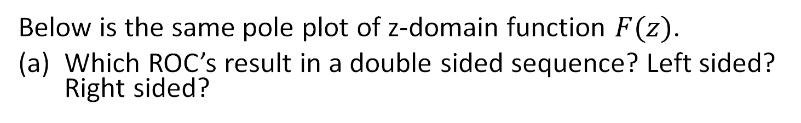
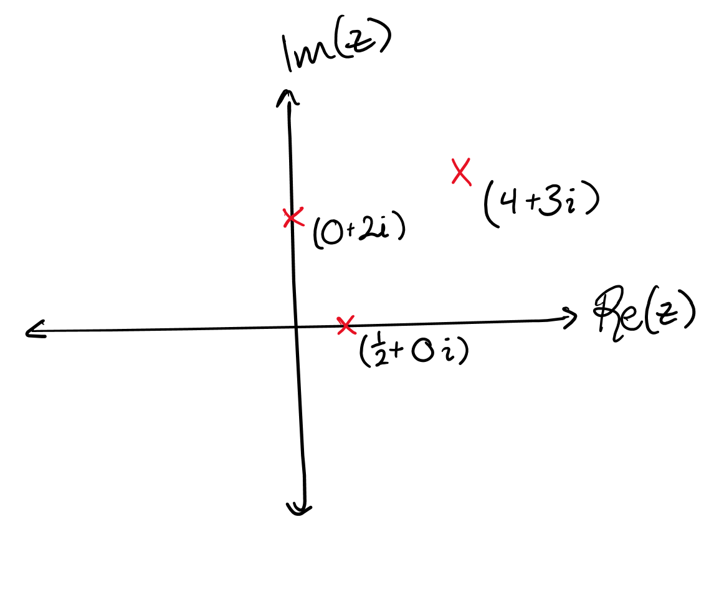
Concept check: Sequences and ROCs
Notes:
Answer:
Left sided: |z| < ½
Right sided: |z| > 5
Double sided: The other ones

Slide 30
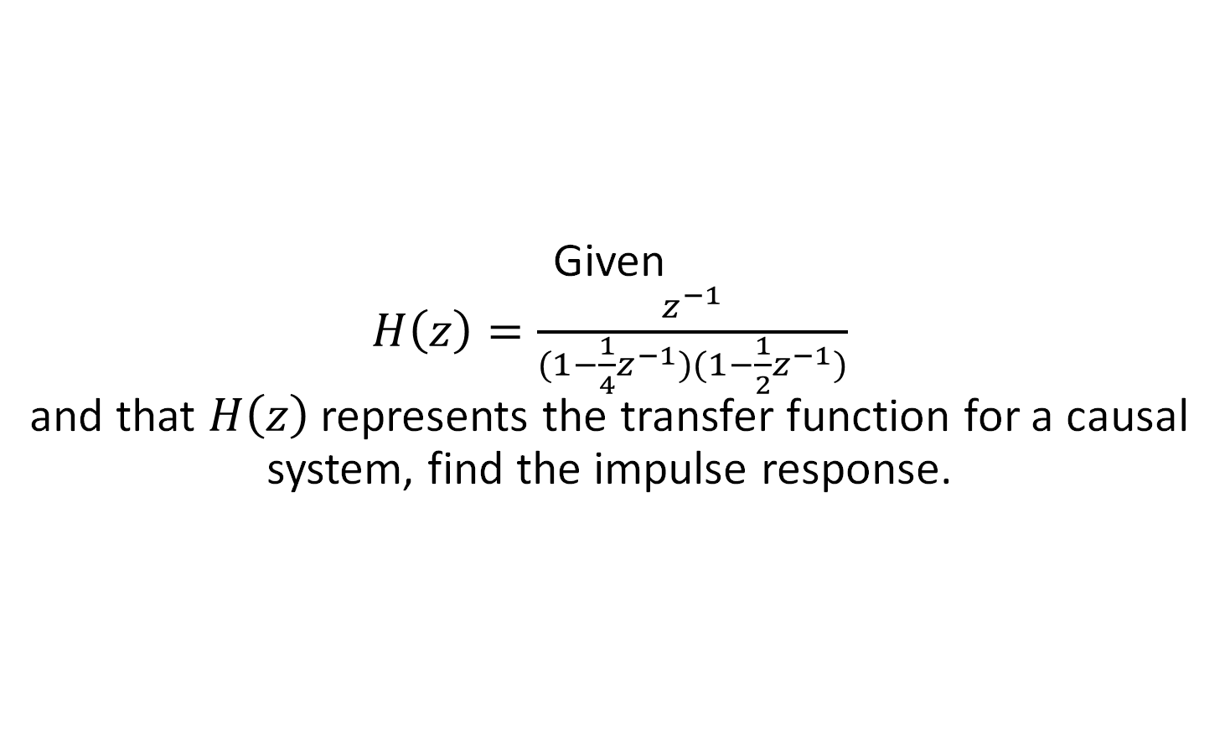
Example: Z-transform to sequence
Notes:
Coverup method; PFE: 4/(1-(½)z^(-1)) - 4/(1-(¼)z^(-1)) ;causality implies |z|>r for some r (choose the largest pole for each ROC); now do table lookup
Eric

Slide 31
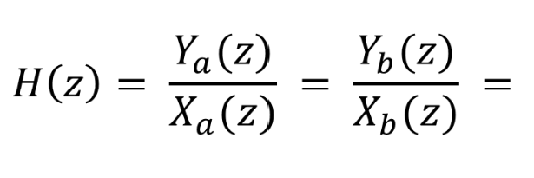
Relationship between LTI systems and Transfer Function
A system H is LTI if and only if…
Its transfer function H(z), the z-transform of the impulse response, exists.
H(z) is equal to the ratio of the z-transform of the output to the z-transform of the input.
This ratio is the same for every input/output pair.

Slide 32
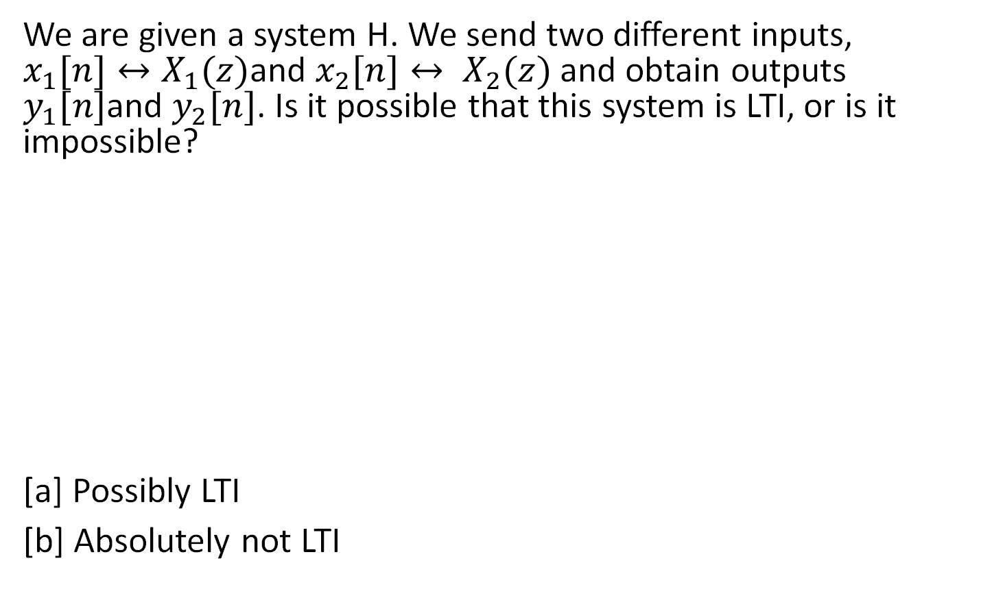
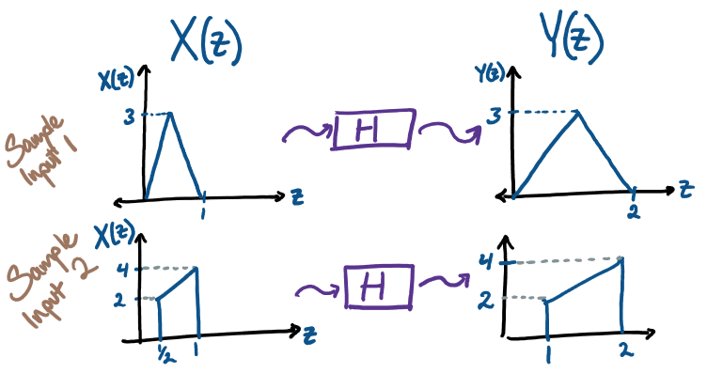
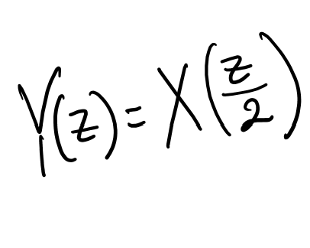
Checking for LTI in the Z-domain
Notes:
Absolutely not.
Justification 1: look at sample 1 input/output. Output has values at z=1.5, but input is zero there.
Justification 2: Cannot manipulate equation into form Y(z) / X(z).

Slide 33
Conceptual Check
Suppose we know a system is LTI. Suppose that some finite-length input 𝑥ₐ[𝑛]↔𝑋ₐ(𝑧) has output 𝑦ₐ[𝑛]↔𝑌ₐ(𝑧).
True/False: If we know that for some 𝑧ₖ, 𝑌ₐ(𝑧ₖ) = 0, but 𝑋ₐ(𝑧ₖ) ≠ 0, then we know that Yany input (𝑧ₖ) = 0.
True/False: Consider some value 𝑧ⱼ. Knowing 𝑋ₐ(𝑧ⱼ) = 0 does not give us information about the value of 𝑌ₐ(𝑧ⱼ).
Notes:
True
False
Finite-length conditions removes any possibility of cancelling zero with a pole

Slide 34
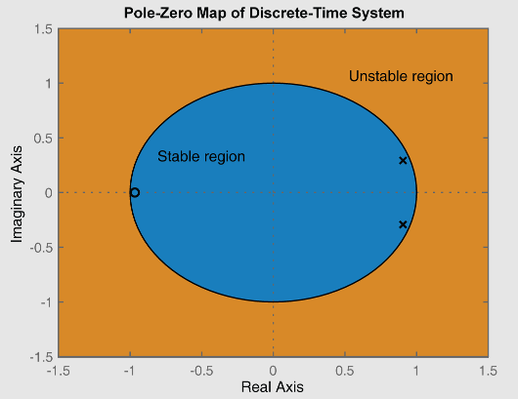
Marginal Stability
A LTIC system is marginally stable if none of its poles have a radius greater than 1, and if it has one or more distinct poles with radius 1.
For a system in general, it is marginally stable if the ROC borders |z| = 1 but doesn’t contain it.
In this class, marginally stable = unstable.
Source: https://in.mathworks.com/help/ident/ref/lti.pzmap.html
Notes:
To find a bounded input that produces an unbounded output, find an input with a z-transform that creates a double pole (i.e. shares 1+ poles with the impulse response)
Also note marginal poles can induce resonance with time-varying signals with frequency that matches the pole

Slide 35
Stability and Causality of LTI systems
Given an LSI system with impulse response ℎ[𝑛] ↔ 𝐻(𝑧):
H is BIBO stable if and only if the ROC of the z-transform 𝐻(𝑧) includes the unit circle.
H is causal implies that the ROC of 𝐻(𝑧) has form |z| > r for some r.

Slide 36
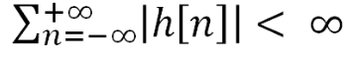
BIBO Stability of LTI systems
Checking for BIBO stability of LTI systems
Absolute summability of impulse response
i.e.
Location of poles and ROC of the transfer function
ROC must include unit circle (poles + causality)
System definition (proof by counterexample)
Find a bounded input that produces an unbounded output

Slide 37
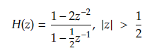
Example
Find the LCCDE for the system.
Is the system BIBO stable?
Notes:
H(Z) = Y(Z)/X(Z)
= (1-2z^-2) / (1-.5z^-1)
<=> Y(Z)[1-.5z^-1] = X(Z)[1-2z^-2)
Take IZT
Answer: y[n] - .5y[n-1] = x[n] - 2x[n-2]
Answer: |z| > ½ contains unit circle, thus it is stable.

Slide 38
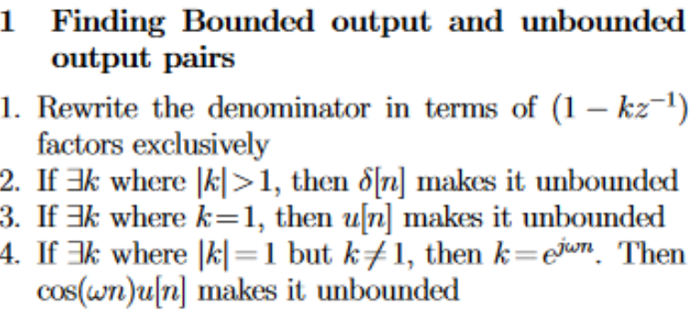
A semi-mechanical way to find BIBO unstable pairs

Slide 39
Conceptual Question
If a system is BIBO stable then it must be causal. T/F
Notes:
False, if there is an anticausal system with a pole greater than 1, the UC is inside the ROC

Slide 40
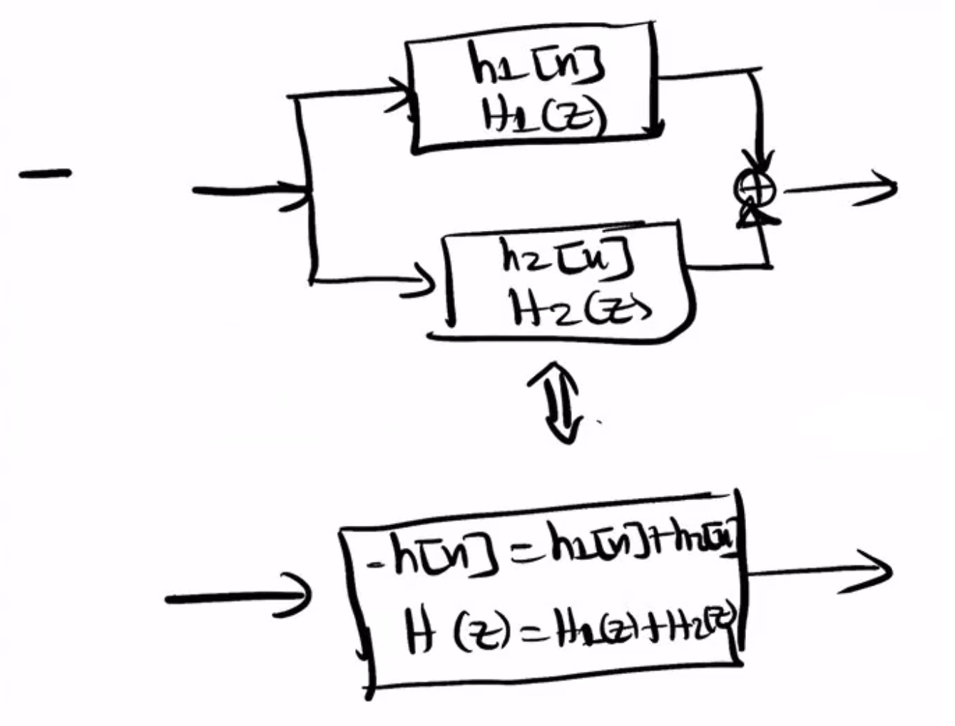
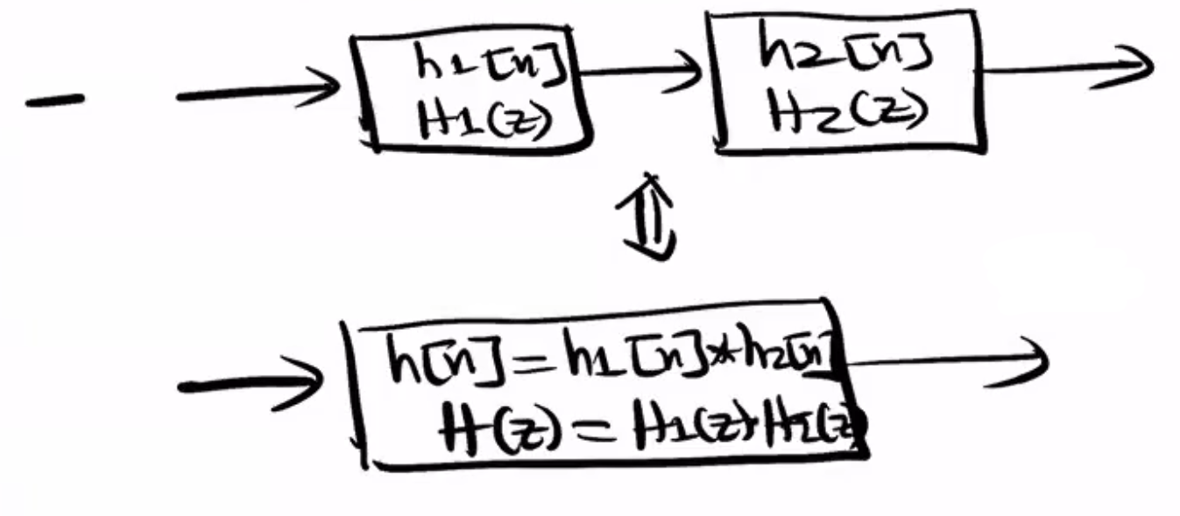
Multiple Systems
We can combine systems in serial or parallel connections.

Slide 41
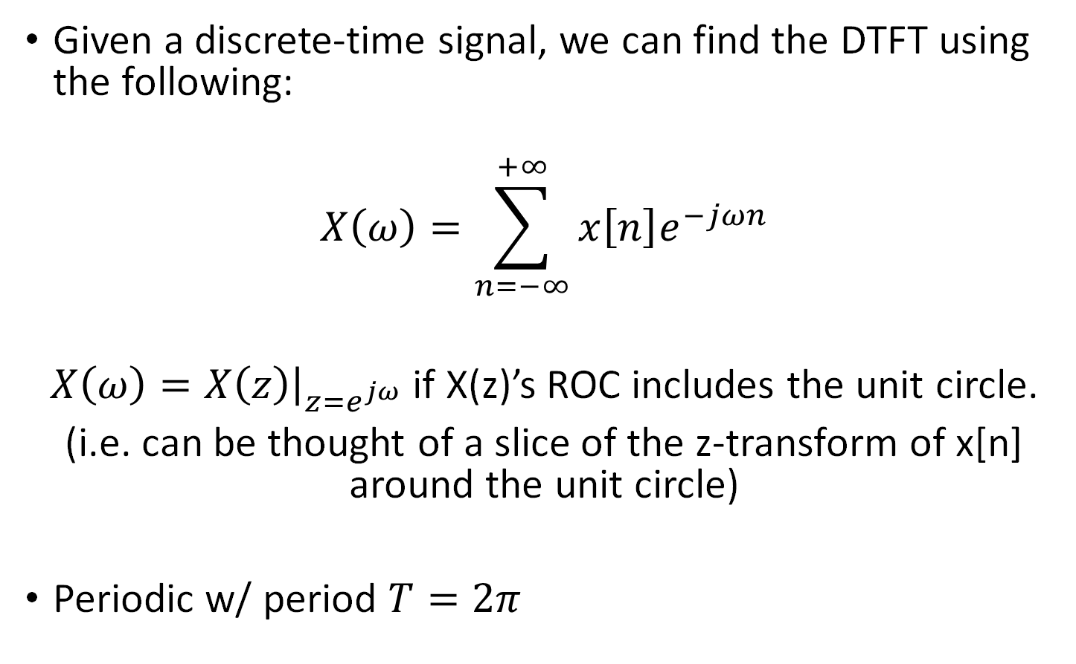
DTFT
Notes:
Z-transform is a special case of DTFT!

Slide 42
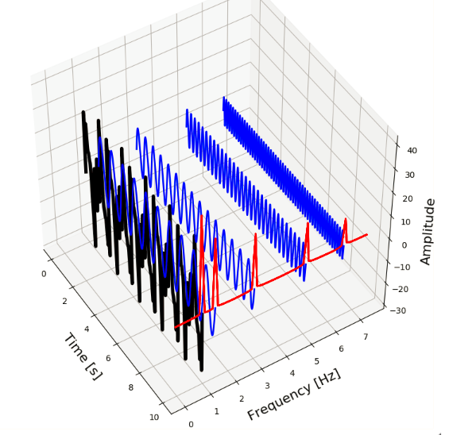
DTFT
What does the DTFT tell us?
Frequency content of a discrete signal
Magnitude and phase response of a system
Notes:
X(n) = δ(n) + δ(n-1) => Xd(w) = 1+e^(-jw)
Very simple example showing mag/phase

Slide 43
Conceptual Question
The DTFT of a sequence always exists as long as its z-transform exists. T/F
If the z-transform of the function does not include |z|=1, then the DTFT of the sequence does not exist. T/F
Notes:
False. The system must be BIBO stable and its ROC must include the unit circle.
False. u[n], cos[n], sin[n], all have DTFTs.

Slide 44
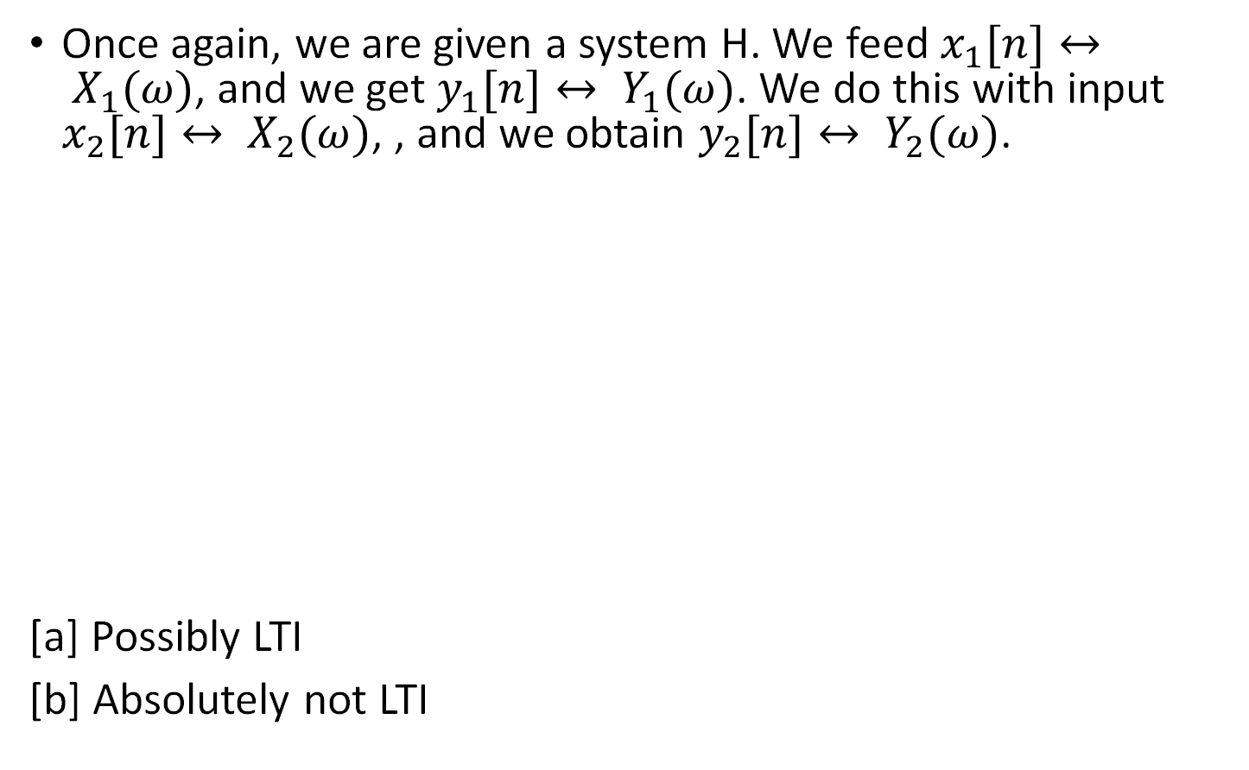
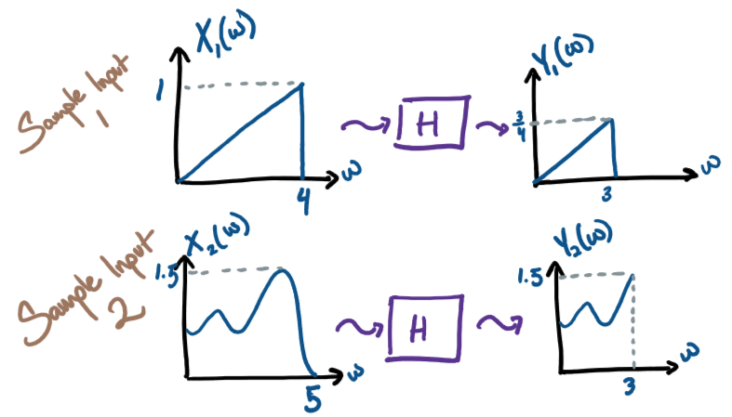
Concept Check: LTI and DTFT
Notes:
Possibly:
All

Slide 45
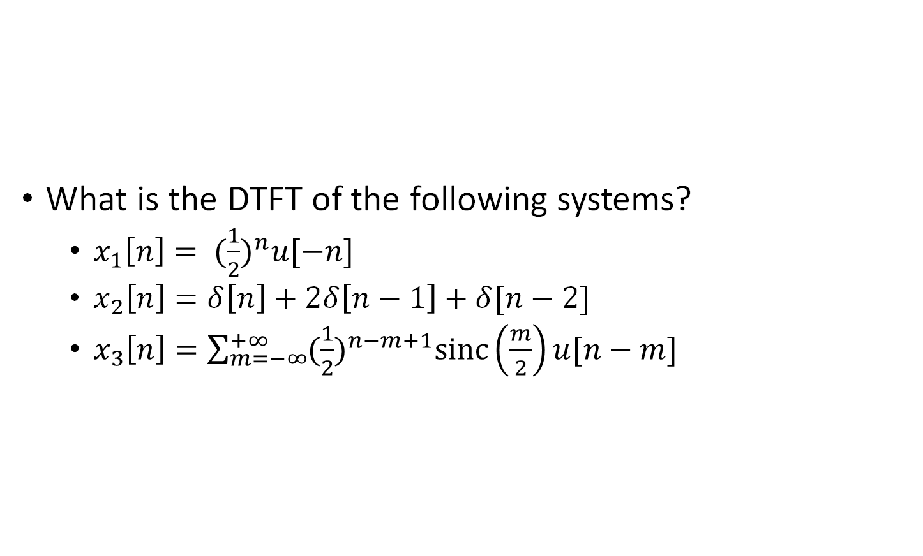
Finding DTFT
Notes:
1) 1/(1-½e^(jw))
2) 1+2e^(-jw)+w^(-j2w)
3) lol
Use the tables!

Slide 46
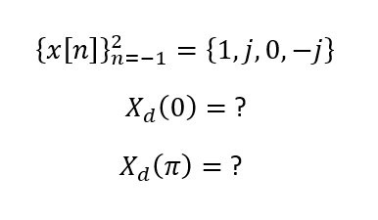
DTFT Question
Notes:
1+j+0+(-j) = 1
-1+j+0+(-j) = -1
Hint: Go directly to the definition of the DTFT

Slide 47
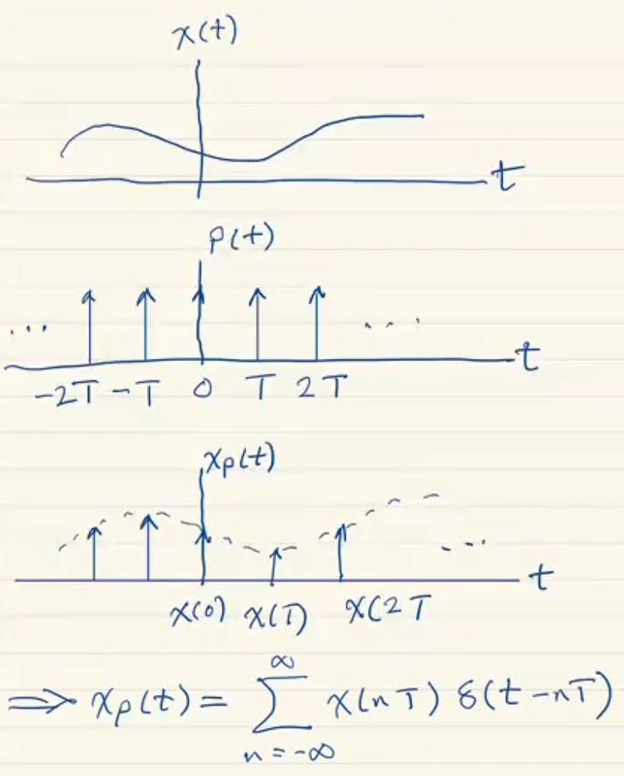
Sampling
We can multiply a function by an impulse train to sample it.

Slide 48
Bonus: ECE 310 MT1 any speedrun tactics
Time is a concern
PFE: change of variable / direct PFE
Polynomial division: Google “synthetic division”
Useful if the denominator is factorable into single-root terms
Tables: Use the properties and table pairs whenever you can!
Z-transform pairs/properties, DTFT pairs/properties: learn them by heart, or find a place on your reference sheet to put them.

Slide 49

Thank you!
Good luck on Midterm 1!
Let us know if we were helpful:
Notes:
Tell them to click on review session feedback

